Slide 1
HC Knole Park AGM
2019/20

Slide 2
Season Summary Video Part 1

Slide 3
Agenda
Welcome and Introductions
Apologies for Absence
Chairperson’s Report
Treasurer’s Report
Election of Committee
AOB

Slide 4
Willemijn’s Video

Slide 5
Duncan’s video

Slide 6
Season Summary Video Part 2

Slide 7
HC Knole Park
A forward-thinking, creative and inspirational hockey club for
all hockey players wishing to progress their hockey
FINANCE REPORT 2019/20
Sue Foxley, HC Knole Park Treasurer

Slide 8
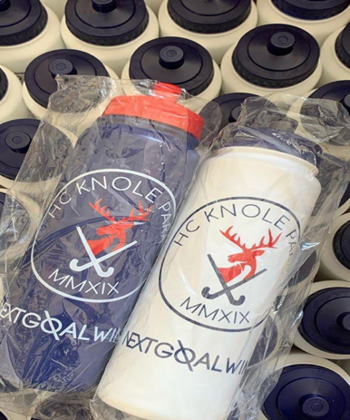
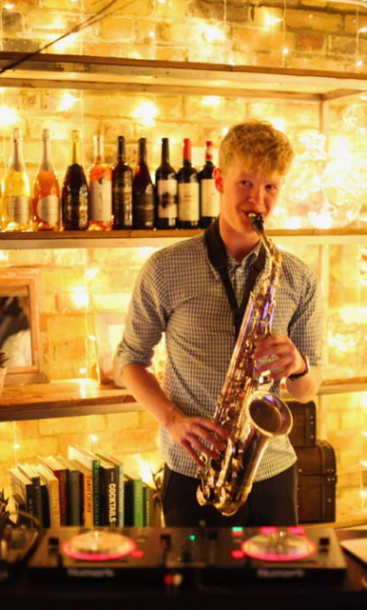
Income
From zero to 160+ members, four sponsors and two grant awards
 | Income
Subscriptions | £29,455
Sponsorship | £4,500
Fundraising | £2,672
Lottery Grant | £1,000
Other Income | £6,404
Tournament Contributions | £2,083
Total Income | £46,114
Other income – predominately match fees
Tournaments largely broke even
Fundraising – your generosity and creativity made a real difference
Lottery Grant for much needed equipment and safety gear
Kent Sports Grant awarded in May but will fall into 20/21 financial year

Slide 9
Expenditure
Our first year was always going to be a challenge, but we made it!
Pitch Fees
Coaching
Total expenditure of £45,449
Pitch fees are, and will remain, our largest cost
Significant kit outlay for first season
Administration costs- Stripe, MyClubHouse, bank fees and insurance
Other costs include Affiliation and league fees, match teas and training
Kit
Administration
Costs
Tournament Entries
Other

Slide 10
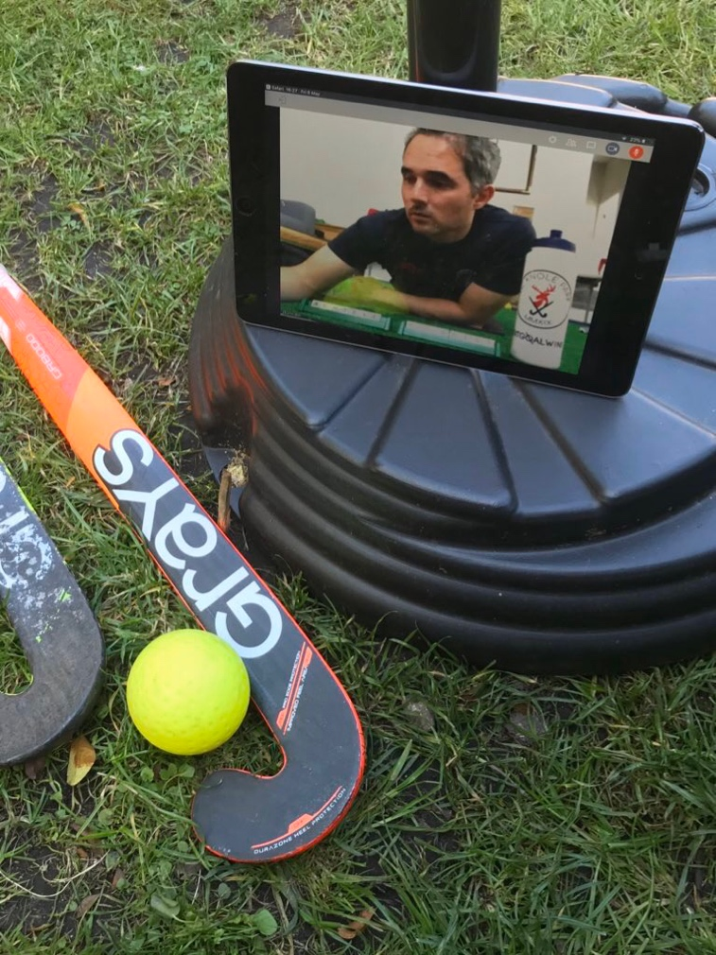
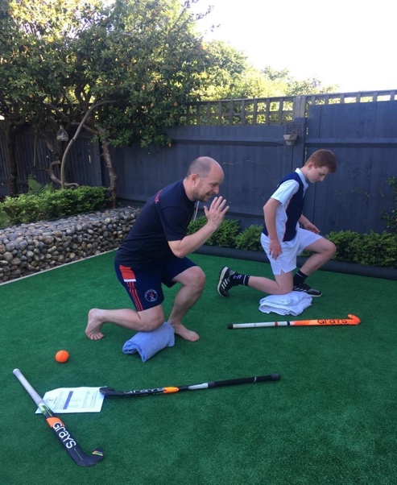
Cash reserves
Despite a foreshortening of the season we were able to invest in lockdown support for our membership
£664
Year end balance 2019/20

Slide 11
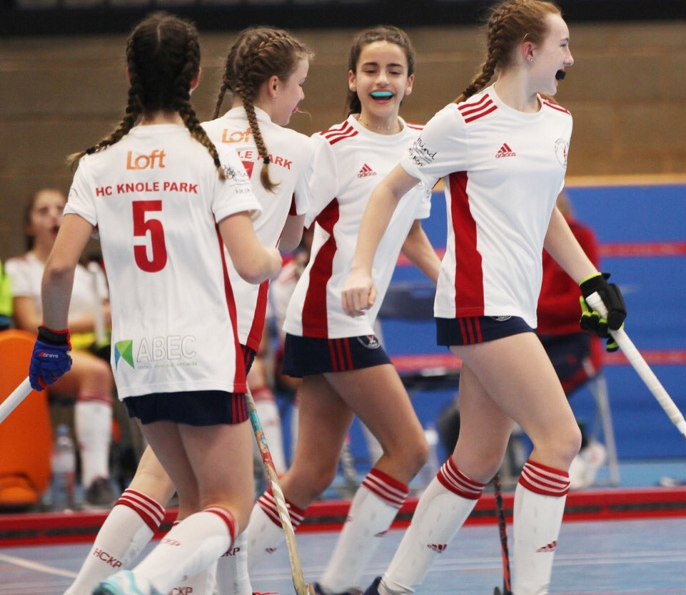
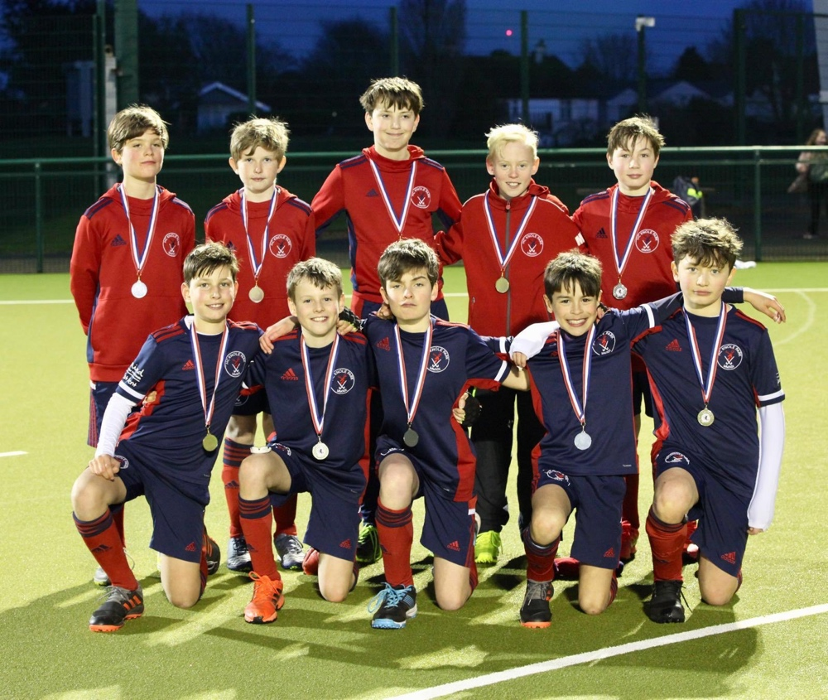
Financial considerations for the future
Our focus over the last season has been on set-up, launch and first season activity; our financial planning now looks to next season and the longer term vision for our club
2020/21 Season
Medium/Long Term Goals
Replace and grow our sponsor income
Increase coaching renumeration closer to market level
Register as an Community Amateur Sports Club
Build our reserves
Pursue further grant opportunities
Secure accountant experience to the Committee ✅
Set aside funds for new and replacement kit /equipment e.g. indoor boards
Increase funding for coaching to support future coaching team
Provisions for bursaries, professional courses and mentoring
Secure funding / EH grant support for a ‘home ground’ location as opportunities evolve

Slide 12
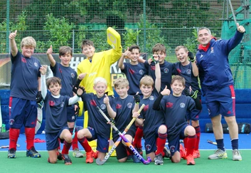
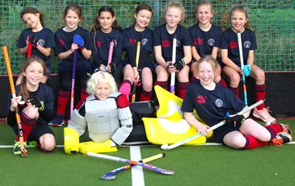
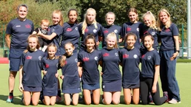
And finally… thanks!
Many thanks to Emma King for all her work for the club
Well done to Dale Carman for stepping up as our new Treasurer!
Thanks to Emma Harrison for setting up systems and securing Lottery grant
Big thank you to the Committee – amazing dynamic bunch and in particular our coaches
And, to all our members for such unyielding support
Copy of this 2019/20 Treasurer’s report available from the Treasurer upon request. Members are welcome to inspect the club’s finances at any time. Hckp.treasurer@gmail.com

Slide 14
Any Questions? Accounts Sign Off

Slide 15
HC Knole Park
Committee Structure
2020/21

Slide 16
HC Knole Park’s aim:
To be a forward-thinking, creative and inspirational hockey club
for all hockey players wishing to progress their hockey.
At our core, all our actions, in all areas of the club will come back to achieving this aim.
As a result we have designed the HCKP Pod Committee System which we believe will help us to achieve this.

Slide 17
The HCKP Pod Committee System
The Aims
To have a streamlined Main Committee who oversee and are active all areas of the club.
To have an extended network of pods and external experts designed to give all members the opportunity to contribute to the club.
A system designed to allow all those involved to have ownership of their given area of expertise and thrive through creative and interactive meetings.

Slide 18
The HCKP Pod Committee System
The Aims
The pods should give everyone involved enough contact time together to allow for the sharing of ideas, creative thinking and positively aligned outcomes, without taking up people’s precious personal time.
To formalise consistent, clear and concise communication pathways back into the Main Committee with ‘Recommendations for Action’.

Slide 19
Proposed for 2020/21:

Slide 20
HC Knole Park
Election of Officers
2020/21

Slide 21
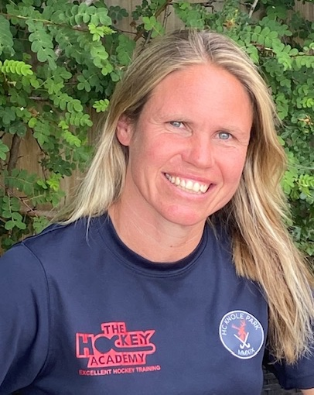
Ruth Bingham
Position:- Club Chair & Welfare Officer
Strengths:-
Motivated, empathetic, hard working, enthusiastic and sociable.
What do I bring to HCKP?
A wealth of hockey and sports knowledge as a sports science graduate, a qualified PE teacher, a level 2 hockey coach, a player and an umpire.
An understanding and empathy of children as a teacher and a mother of 4 children.
A determination & passion to continue to develop a happy, positive and successful environment for everybody at KP to enjoy their hockey both on and off the pitch. For every individual to achieve their potential.

Slide 22
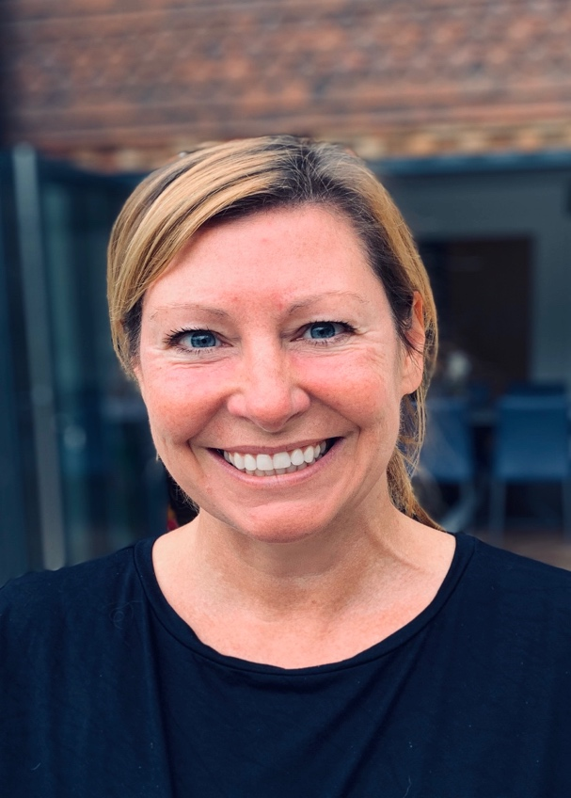
Kelly Burden
Position:- Club Secretary
Strengths:-
Enthusiasm, organised, committed, integrity & fun.
What do I bring to HCKP?
My organisational skills gained from working in a London Law firm for 15 years.
Being a mum to 2 sporty kids, one of which is hockey obsessed! Through managing her team last season it has given me a real insight and experience of the club and its set up.
Being on school committee for many years organising and running events.

Slide 23
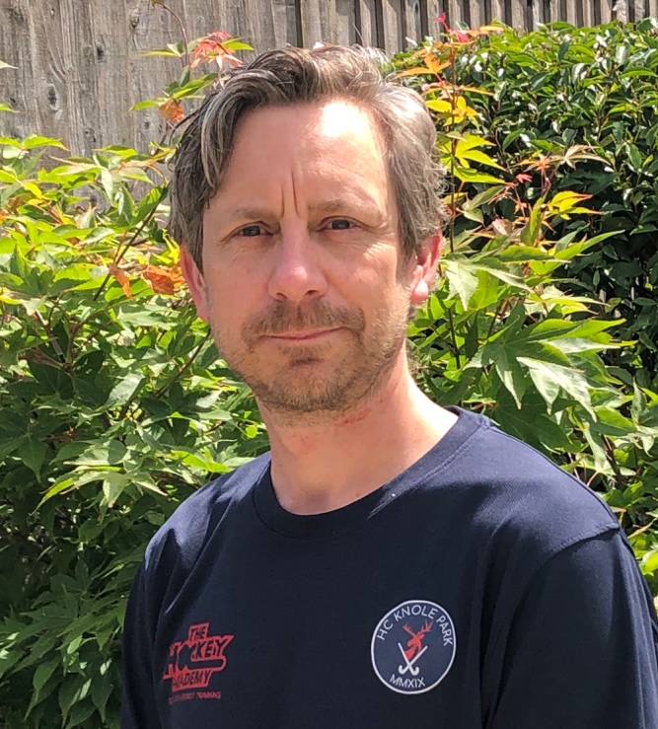
Dale Carman
Position:- Treasurer
Strengths:-
Hard working, enthusiastic, highly organised, encouraging & sociable.
What do I bring to HCKP?
A Finance Director and qualified accountant with over 20 years experience.
A regulated individual with the Financial Conduct Authority
A willingness to learn and enjoy a new sport.
I have planned and participated in two London to Paris cycle rides, involving 20 cyclists (novice & experts) and 2 support vehicles.

Slide 24
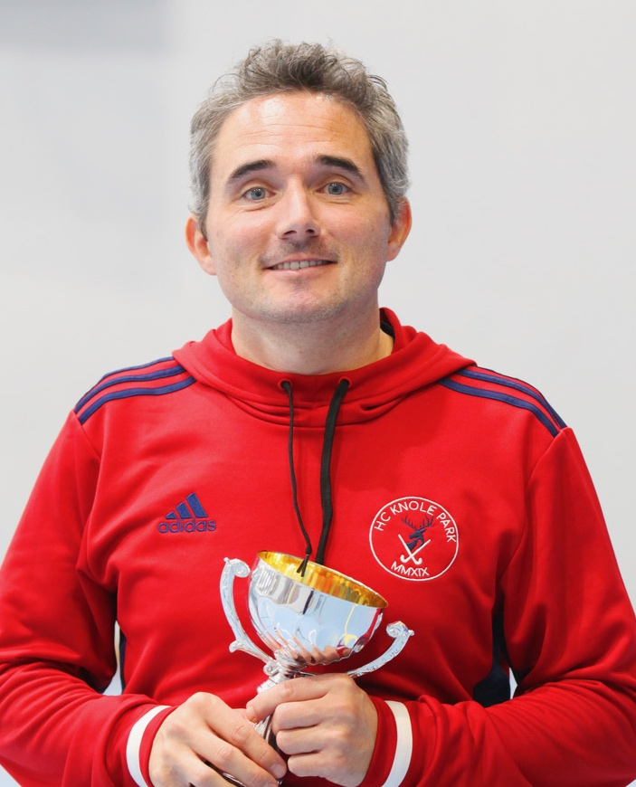
Duncan Parnis
Position:- Junior Development Officer & Director of Hockey
Strengths:-
Motivated, sports coaching knowledge, hard working, creative & a team player.
What do I bring to HCKP?
Hockey and coaching knowledge: Level 3 Coach in hockey and tennis, qualified PE teacher, various other certificates, but fundamentally a bit of a coaching geek always searching for ways to do things better!
A determination to help create a club that is completely fair to all members and enables every individual to enjoy achieving their potential.
Knowledge on how to help people become phenomenal hockey players! As part of teams and individuals I have been involved in many incredible hockey journeys and I cannot wait to continue one with each of you over the next few years!

Slide 25
Catherine Medlen
Position:- Welfare Officer
Strengths:-
Kind, sympathetic, calm & approachable.
What do I bring to HCKP?
As a qualified primary school teacher I have significant experience of working with children from all kinds of backgrounds. This is useful in welfare situations.
Mother of two sports loving girls.
Mental Health Awareness trained and able to help grow links with West Kent Mind.
Very approachable, non confrontational and able to remain impartial. It’s unlikely that I’ll fall out with anyone!

Slide 26
Billy Hughes
Position:- Disciplinary Officer & Instagram
Strengths:-
Motivated, willing to help, great sense of humor, enthusiastic and sociable.
What do I bring to HCKP?
A wealth of sports knowledge, as I have both played and managed football teams at a good level and was club captain for several years.
I am a father of 3 beautiful girls aged between 10 & 14, so I feel I understand different age groups & behaviours.
A passion and a desire to help make this fantastic club one of the best junior clubs in the country over the next couple of years. Whilst also helping adults to either get back to hockey or to try hockey for the first time. A club that radiates a happy, positive and successful environment.

Slide 27
Stuart Medlen
Position:- Disciplinary Officer
Strengths:-
Determined, ethical, ambitious & sensible.
What do I bring to HCKP?
I am Global Head of Operations in an Asset Management firm that has grown from $1.5bn to $42bn Asset Under Management during my tenure. I want to use this experience to help HCKP grow.
A willingness to change things, and to look at things in a different light so that we adopt best practices whilst remaining dynamic.
I care for all juniors equally: I believe that we can be a club that is one of the best in the country, that has an increasing membership from hockey and non-hockey families and have a stable financial base.
I enjoy working with Kent Council and other organisations to promote co-operation and to help grow the game.

Slide 28
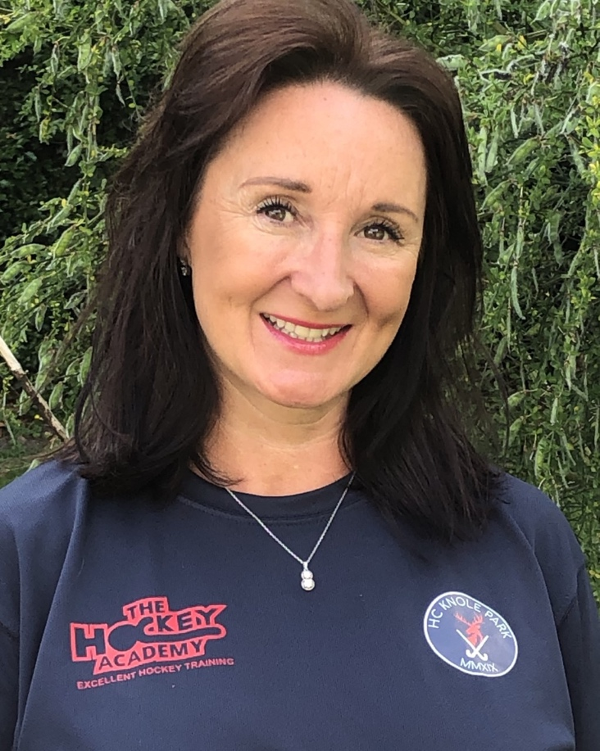
Josie Male
Position:- Social Secretary
Strengths:-
Enthusiastic, positive, motivated, organised, good communicator, reliable, creative, sociable & fun!
What do I bring to HCKP?
A positive mindset to drive and deliver creative/social projects for HCKP; to give members a fun experience both on and off the pitch.
As a mother of 4 and qualified yoga instructor for over 15 years, specializing in teaching children in schools, I have a good understanding of how we can offer a more holistic approach to the well-being of our members.
A passion to help create a real "hockey family" experience for HCKP where all members feel part of a unique and fun club.

Slide 29
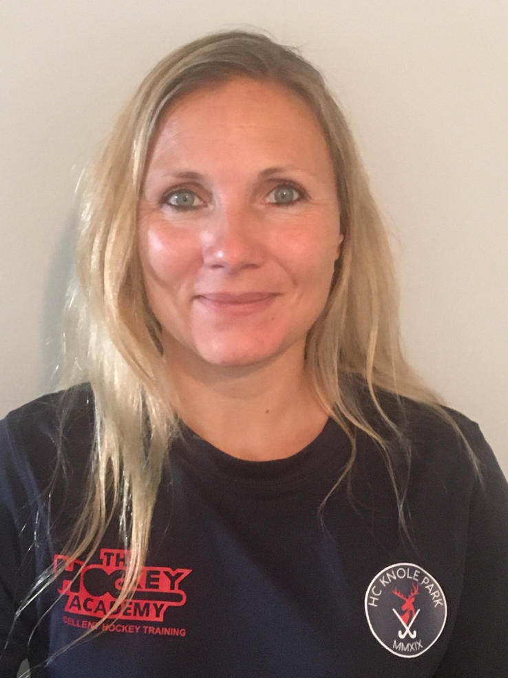
Nadia Dale
Position:- Membership Secretary
Strengths:-
Hard-working, diligent, creative thinker and good communicator.
What do I bring to HCKP?
I’m an Architect and work full-time. I really enjoy working on projects from inception to completion, and watching KP flourish in such a short space of time is testament to the whole club.
I also have three children in the junior section and it has been great to watch the new friendships and teams grow. I also understand the logistical issues of organising your time with regard to training and matches.
I believe a hard working philosophy behind the scenes enables others to focus their attention on the important matters – the hockey! I look forward to watching the club go from strength to strength over the coming years.

Slide 30
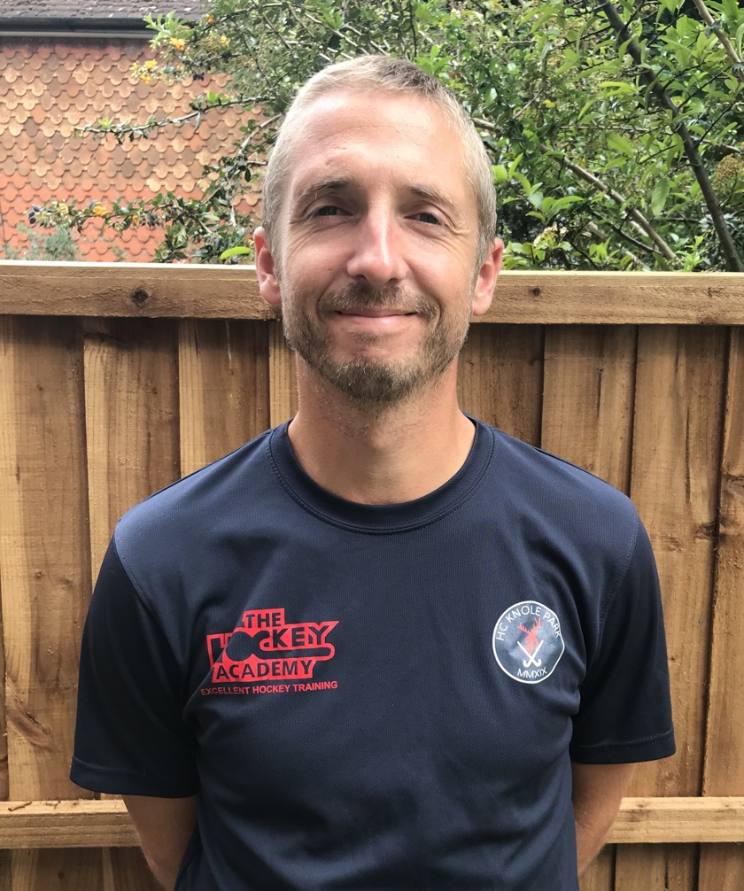
Adam Ward
Position:- Club Captain & Twitter
Strengths :-
Enthusiasm for all aspects of hockey, strong communicator, organized and committed to self development.
What do I bring to HCKP?
A qualified and experienced PE teacher with an in depth understanding of hockey organisation and governance. Currently coaching in school, club and the EH Player Pathway.
Great Britain Advanced Coaching Program 2020 - 2022
I am passionate about contributing to the development of the coaching program at HC Knole Park and I am proactive in sourcing new ideas and/or initiatives.
I am committed to making everyone feel welcome and to making HC Knole Park a friendly inclusive environment for everyone.

Slide 31
I want to help!
If you are inspired by the HCKP Committee and would like to get involved in any capacity through the Pod System please get in contact:
Kelly: hckpsecretary@gmail.com
Ruth: hckp.chair@gmail.com
Duncan: duncan@thehockeyacademy.co.uk

Slide 32
HC Knole Park
Club Constitution Amendments

Slide 33
HC Knole Park
Any other business?

Slide 34
Ruth’s Video

Slide 35
Closing video

